Slide 1
HER2- positive
Inflammatory
Breast Cancer (IBC)
1 week (wk)
16 weeks
Surgery
AC x 4 cycles
RT
HP q3wk
x12
Trastuzumab and Pertuzumab loading dose (HP)
Weekly Paclitaxel + H;
P q3 weeks x 5 doses
Day 1 (D1) Fresh-frozen breast biopsy
(Pre-treatment)
Day 8 (D8) Fresh-Frozen breast biopsy (Post- treatment)
Assess disease response: pCR versus residual disease (non-pCR)
Figure 1B
Notes:
Figure 1. Scheme of prospective single arm phase II clinical trial for newly diagnosed HER2-positive inflammatory breast cancer. H, trastuzumab; AC, doxorubicin, cyclophosphamide; RT, radiotherapy; pCR, pathological complete response; wk, week

Slide 2
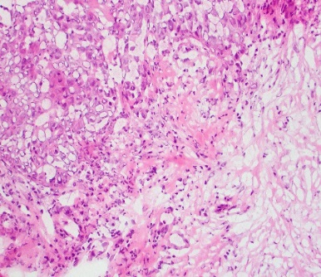
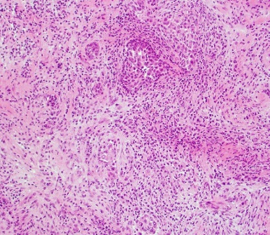
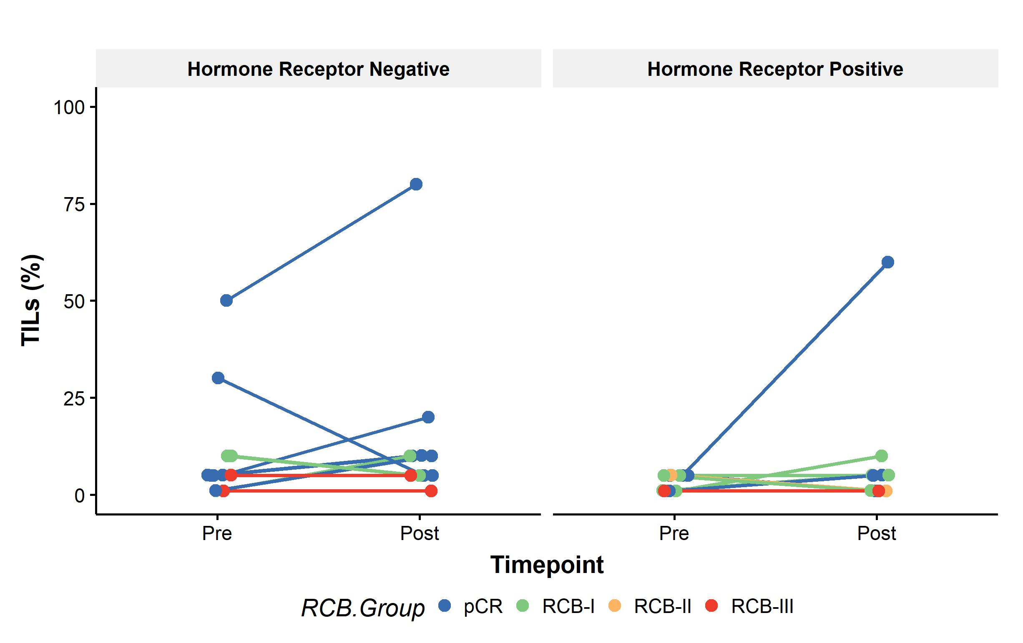
A
D1 (Pre-treatment)
D8 (Post-dual HER2 blockade)
5% TILs
60% TILs
B
Figure 2
Notes:
Fig 2. Changes in TILs in tumor samples obtained pre-treatment and post-dual HER2 blockade. A) representative H&E images of one selected case with an increase in TILs levels from 5 to 60%. B) Individual changes in TIL infiltration between baseline (pre-treatment, D1) and post-dual HER2 blockade (D8) according to hormonal receptor status and pathologic response by RCB (n=22 independent paired patient samples).

Slide 3
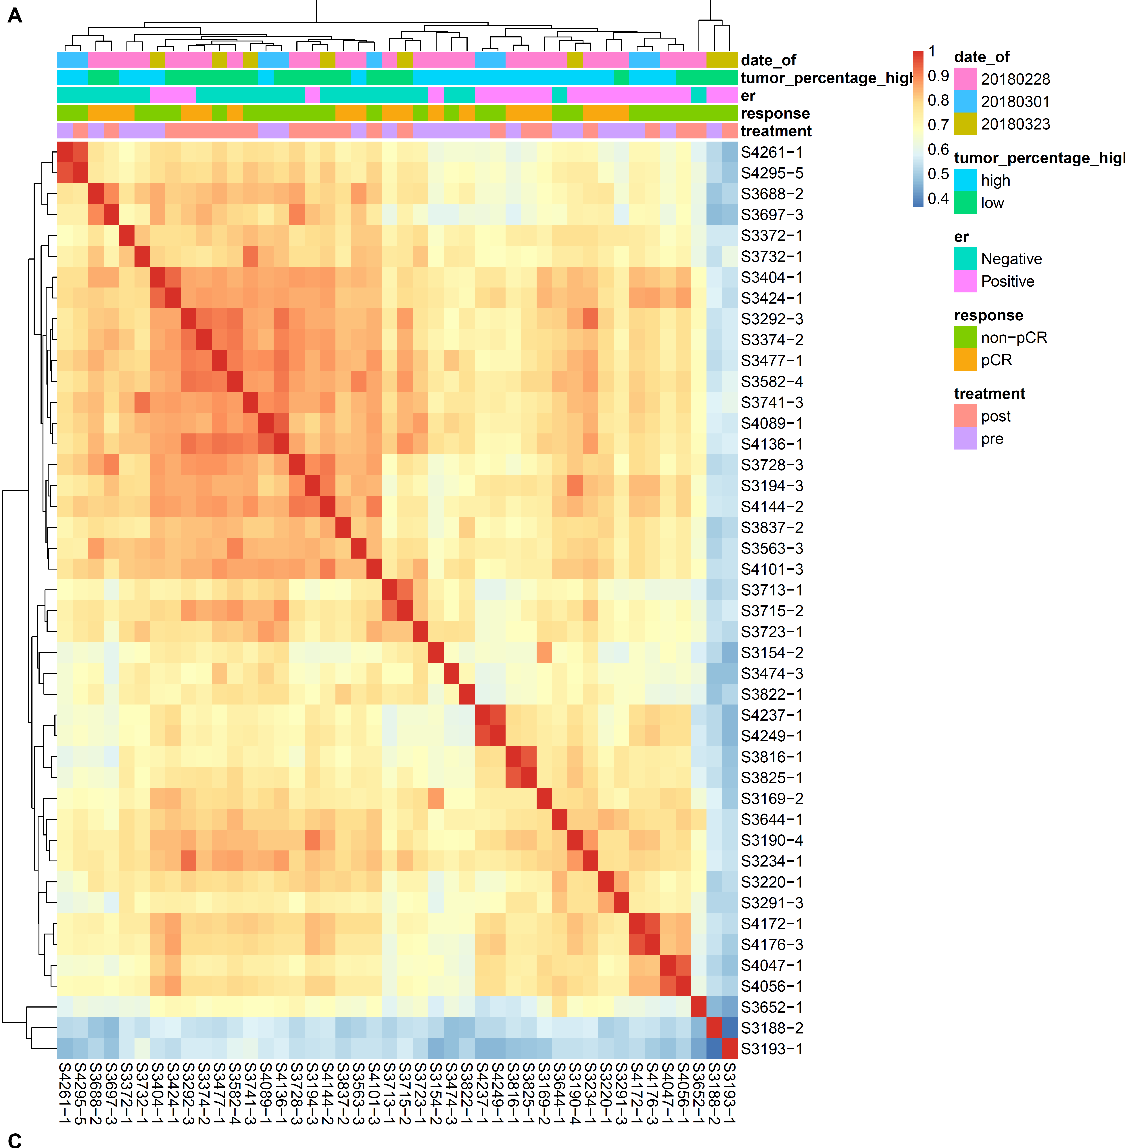
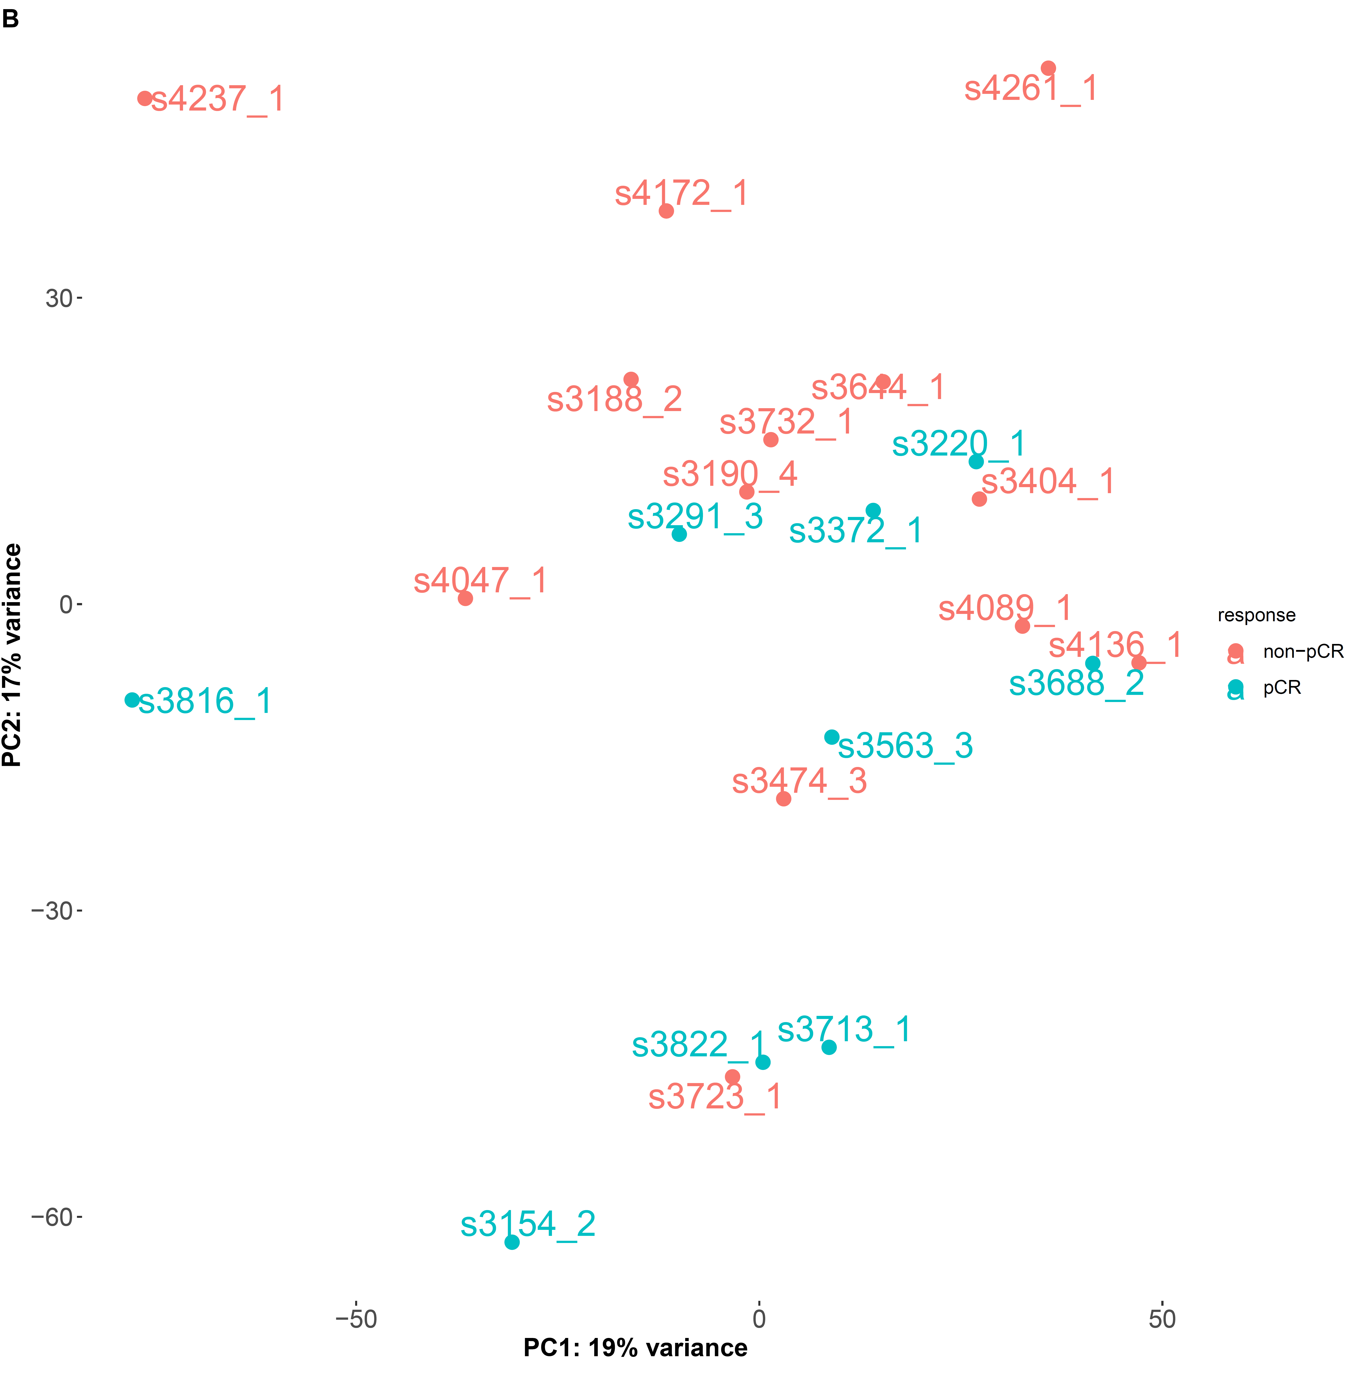
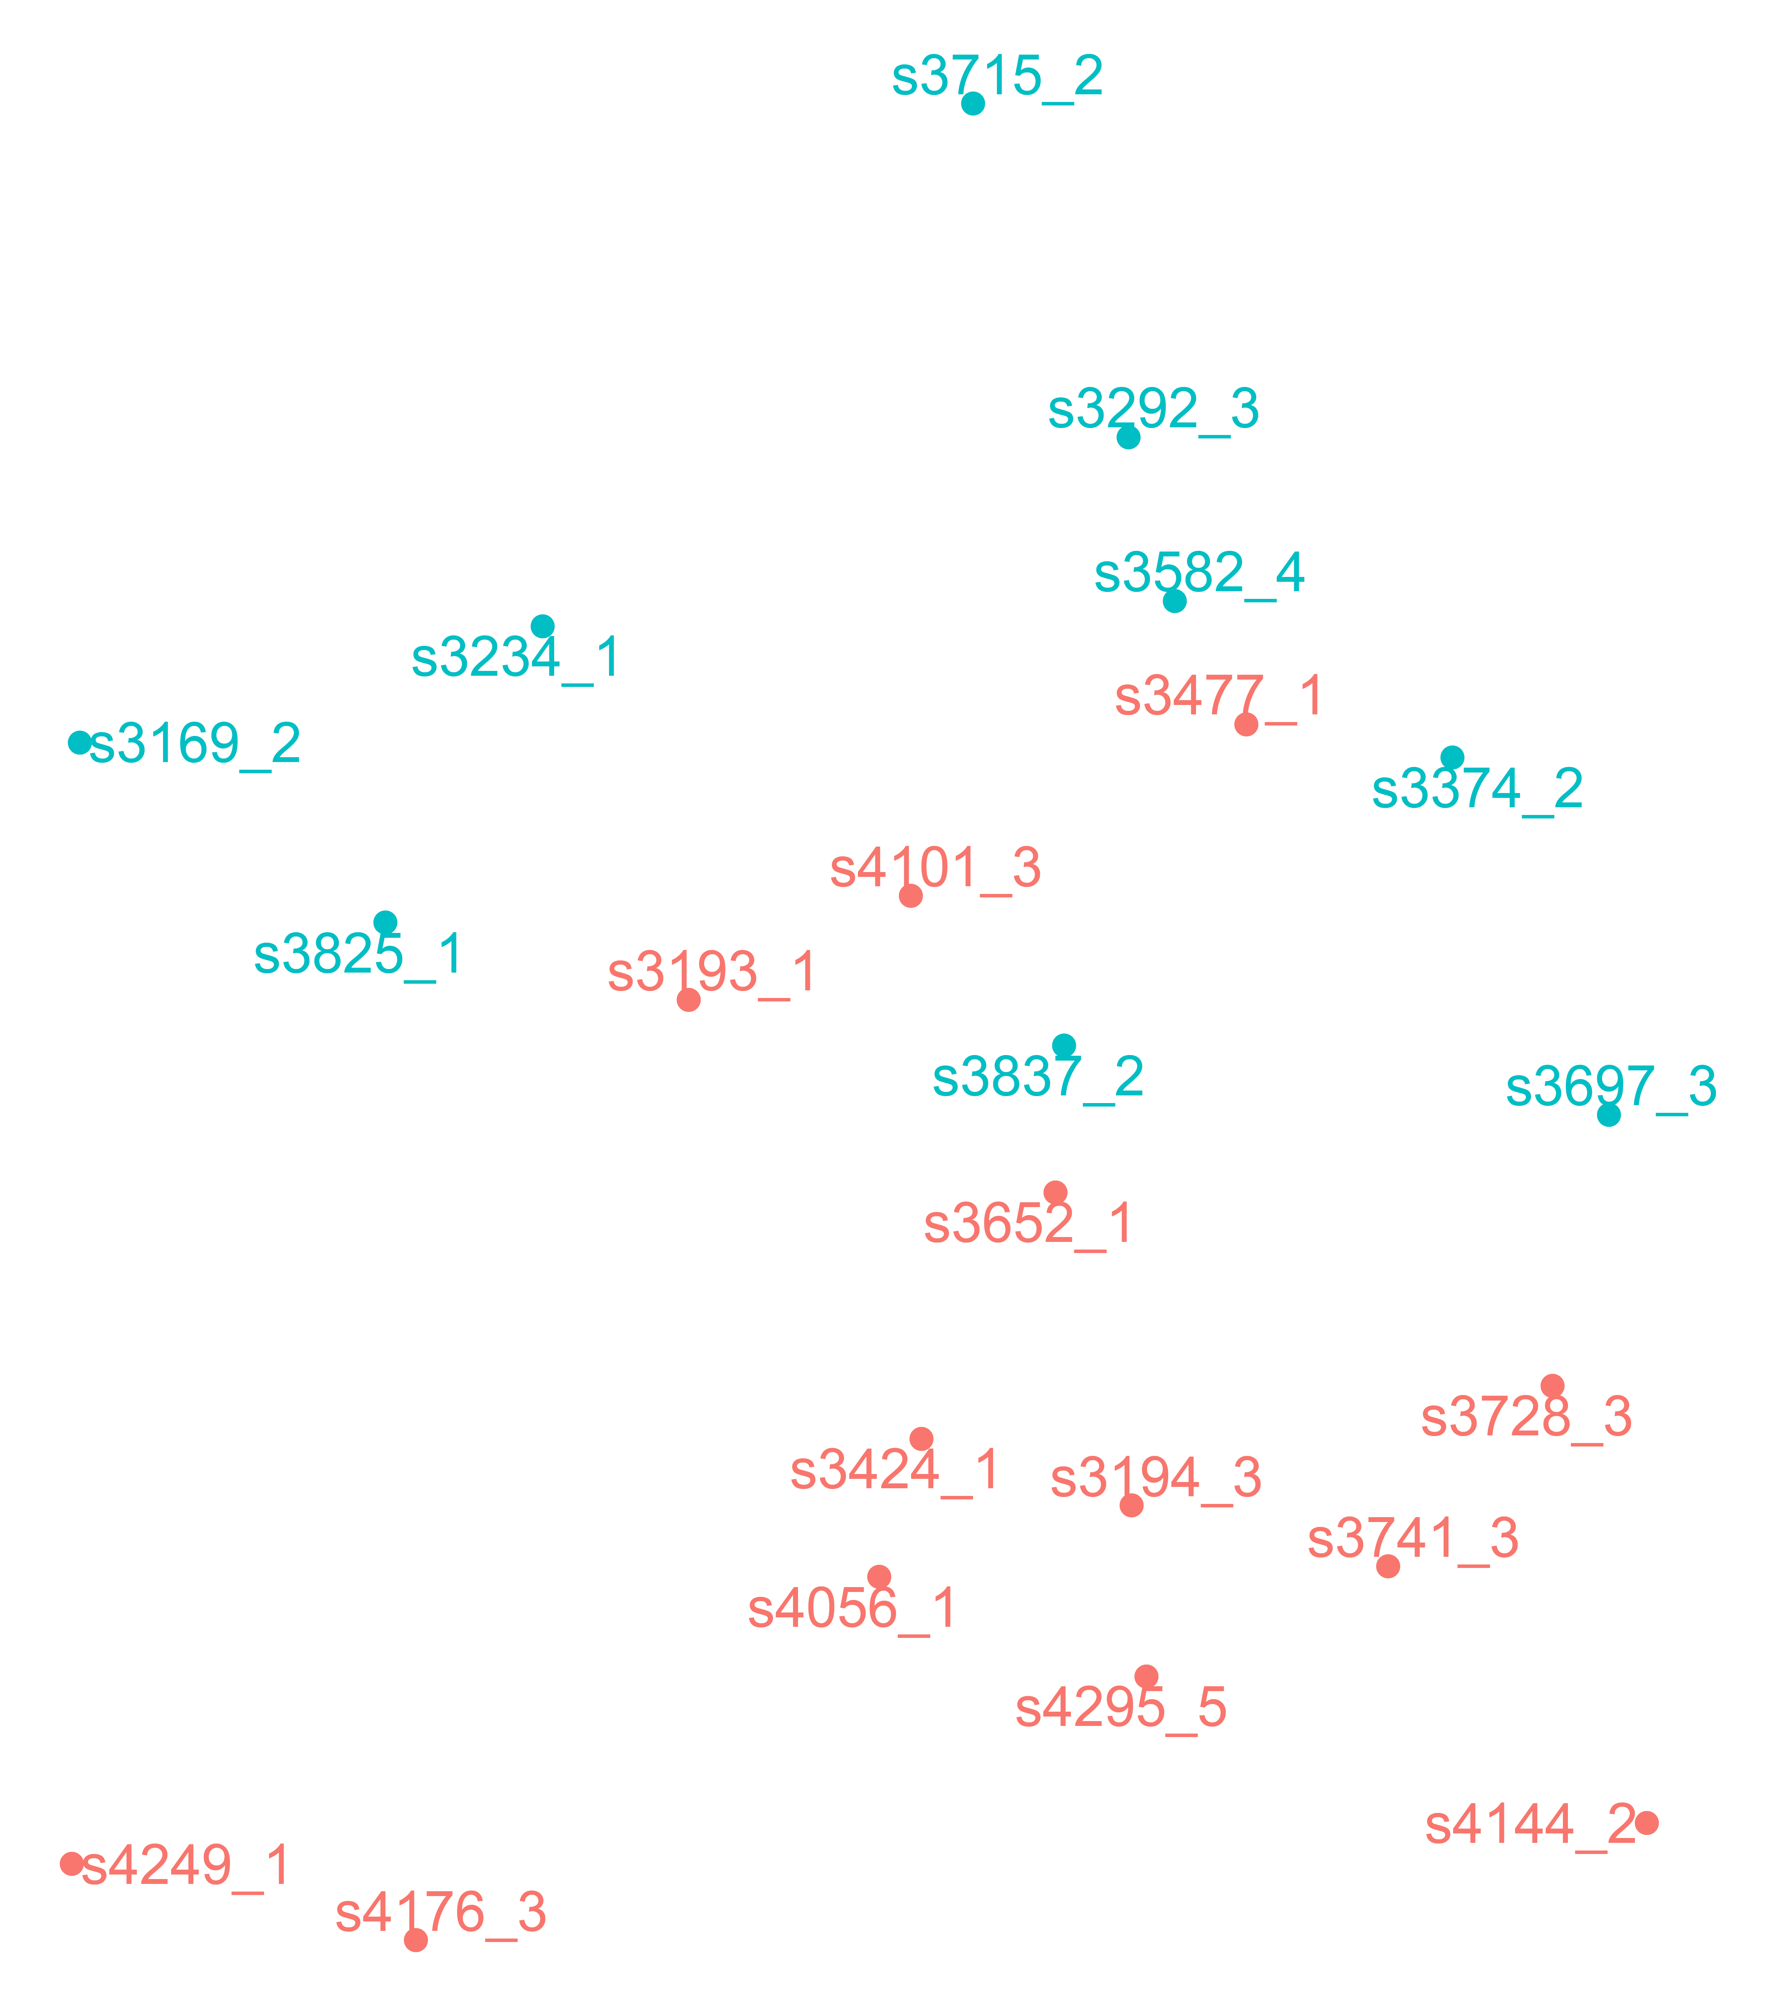
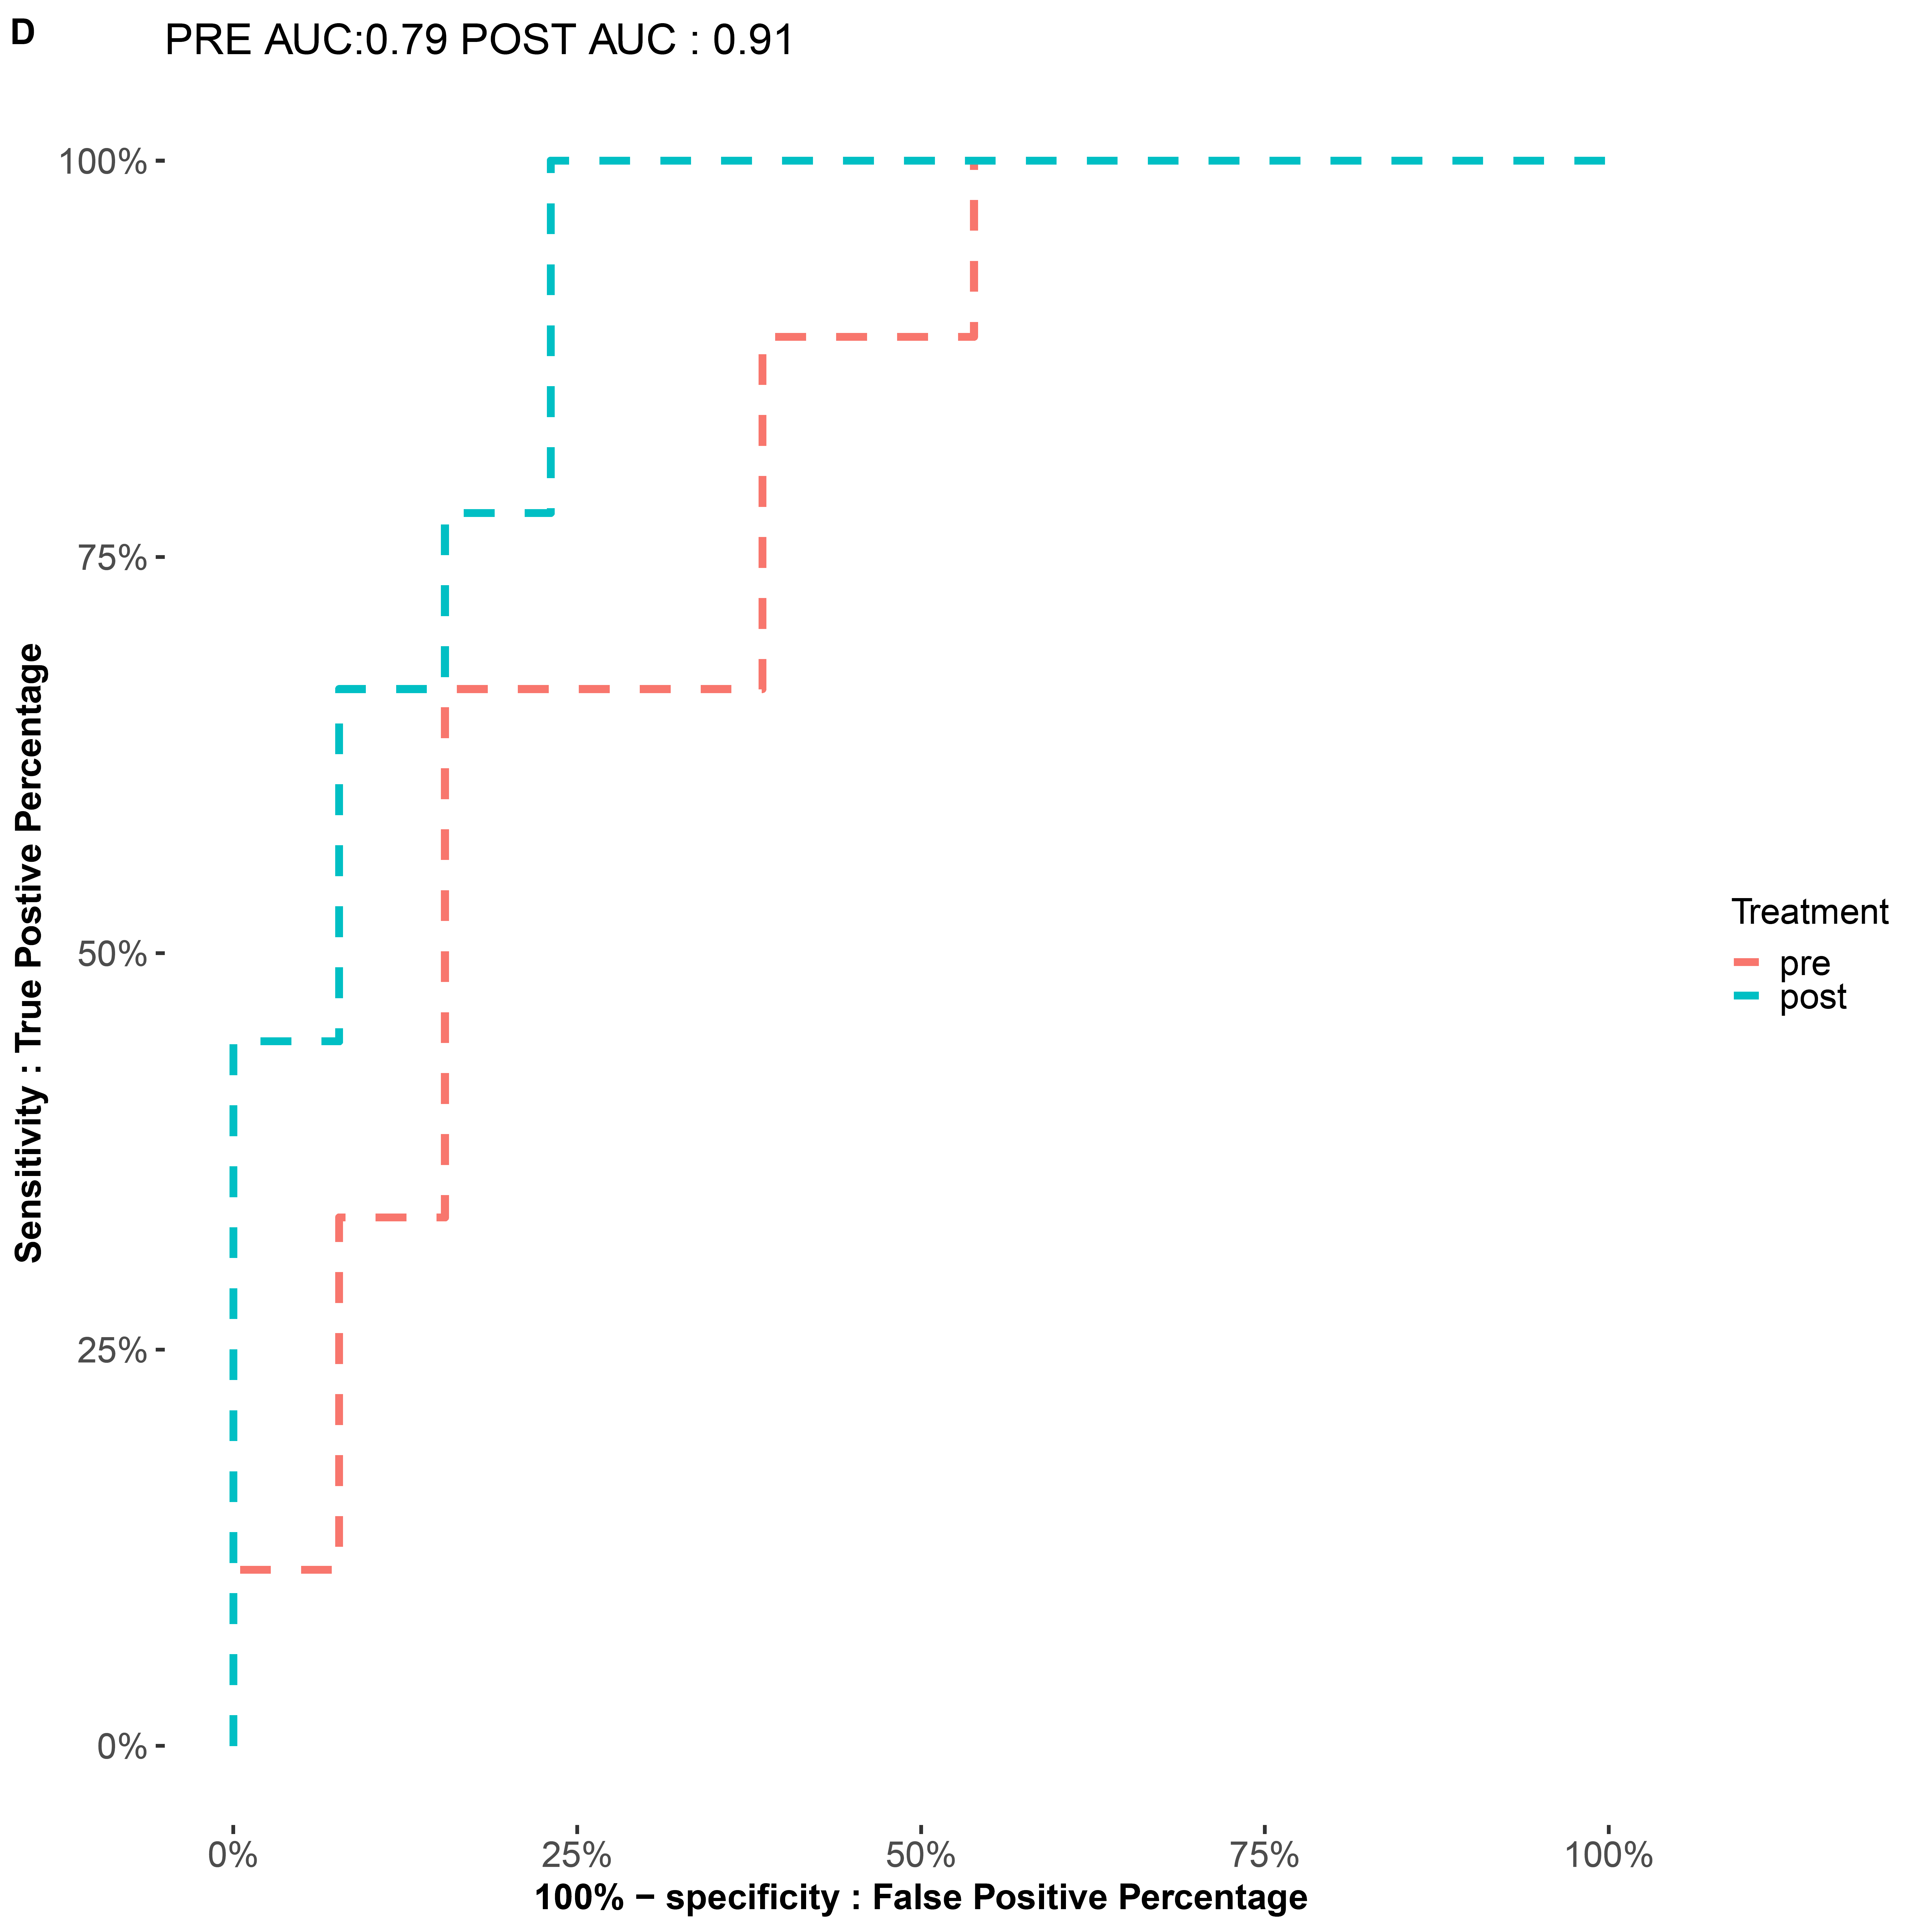
A
B
C
Response
date run
-60
Non-pCR
tumor percentage
ER status
pCR
response
treatment
30
30
0
PC2:17% variance
PC2:17% variance
0
-30
Response
-30
Non-pCR
-60
pCR
-50
0
50
-50
0
50
PC1:19% variance
PC1:19% variance
D
100
Treatment
75
pre
post
50
Sensitivity: True Positive Percentage
date run
tumor percentage
ER status
response
treatment
25
20180228
high
negative
Non-pCR
post
20180301
low
positive
pCR
pre
20180323
1 0.9 0.8 0.7 0.6 0.5 0.4
PRE AUC: 0.79
POST AUC: 0.91
0
0
25
50
75
100
Figure 3
100% Specificity: False Positive Percentage
Notes:
Figure 3. The signal distinguishing responders and non-responders is stronger in Day 8 data. A) Pairwise similarities between top 1000 variable genes of all patients. Individual cells of the heatmap show Pearson correlation values. Rows and columns are annotated with patient IDs. The columns are augmented with metadata describing the date of sequencing, tumor percentage, ER status, whether a patient responded to therapy, and whether Day 1 or Day 8 data was used. B, C) Day 1 (B) and Day 8 (C) data projected onto the first two principal components, computed on the corresponding data slices. Individual points are colored by their response status. D) ROC curves associated with the ability of the second principal component to distinguish responders and non-responders.

Slide 4
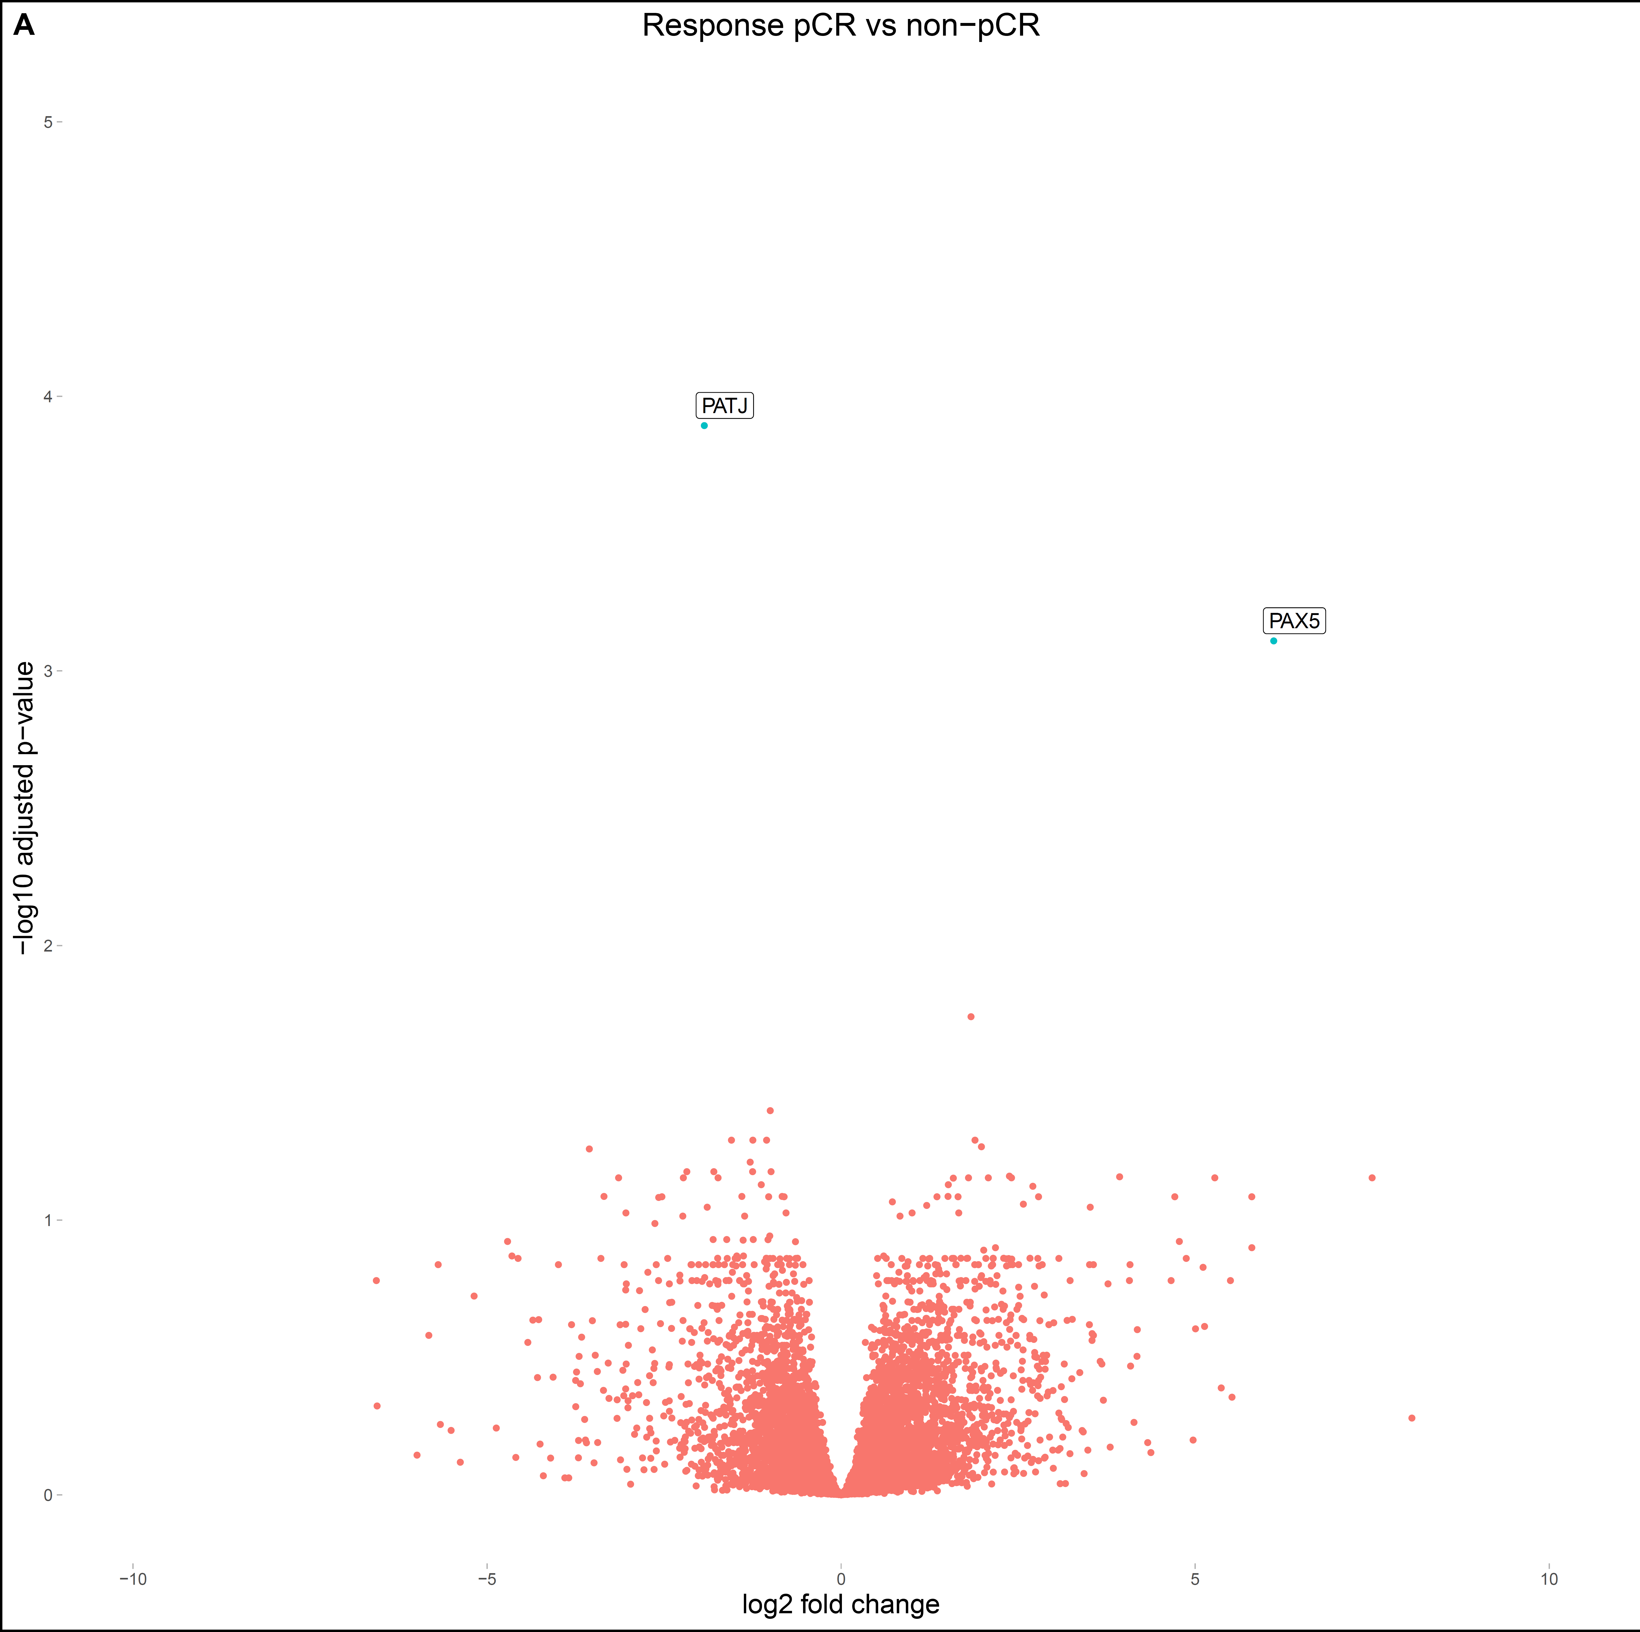
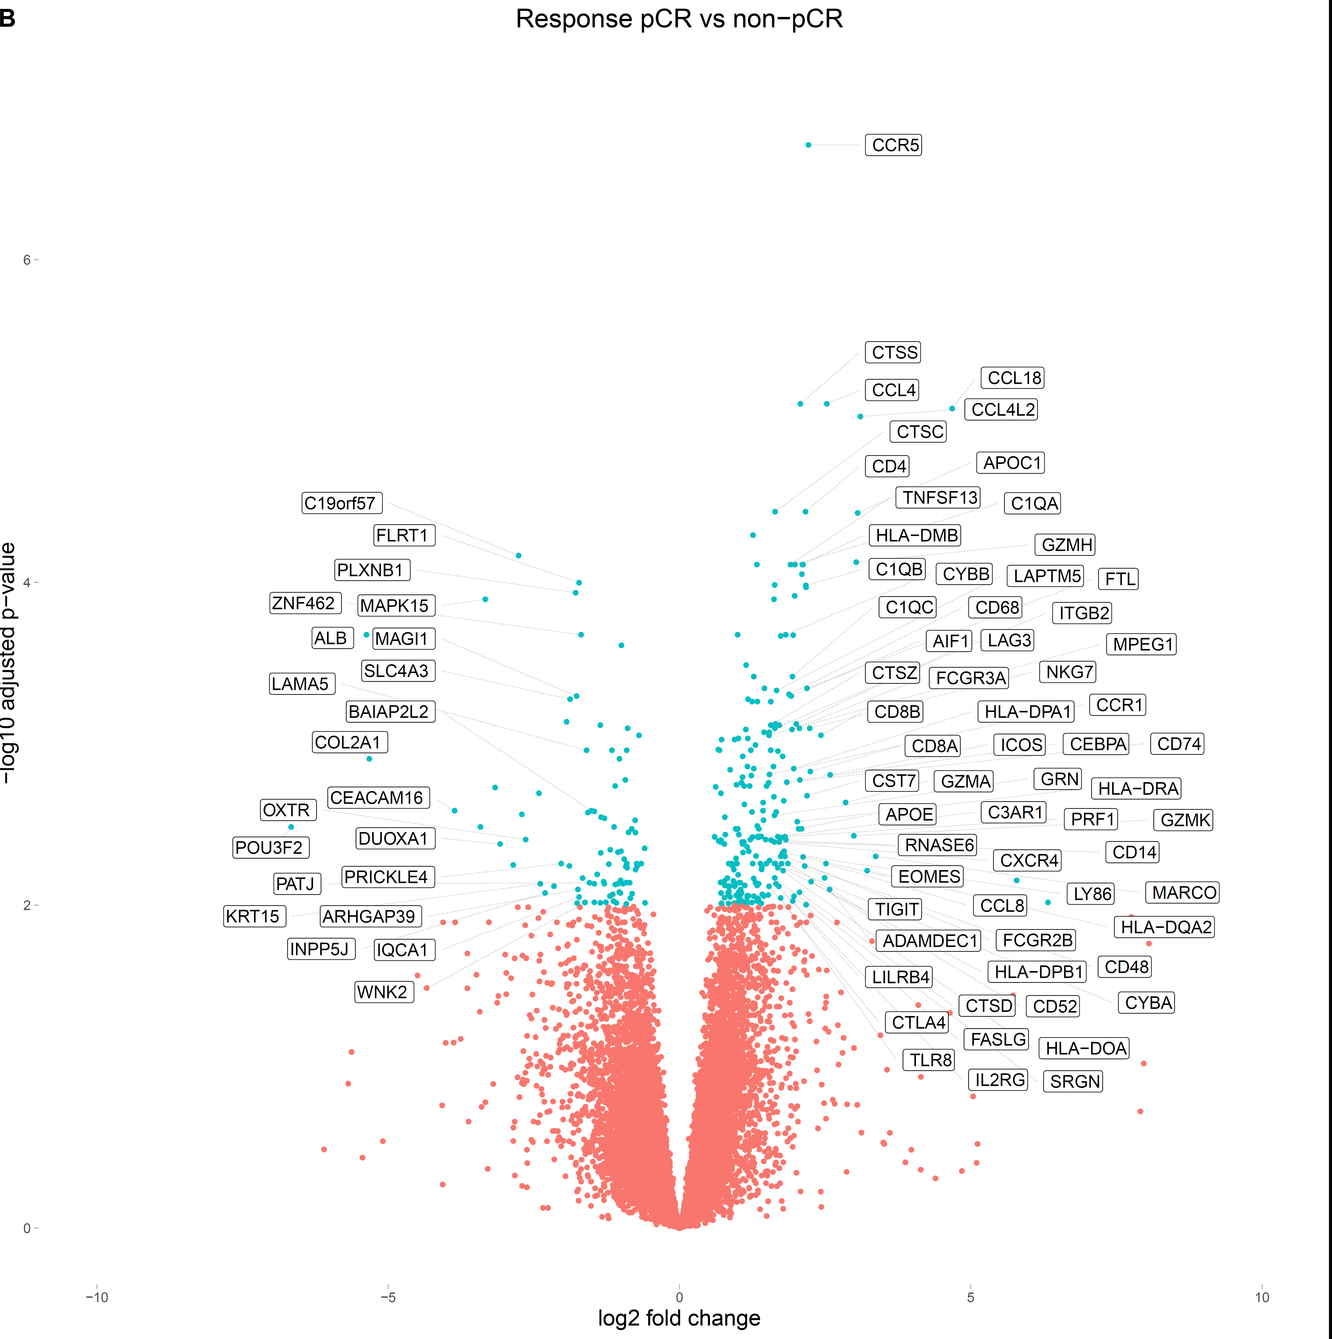
A
D1 pCR vs Non-pCR
B
D8 pCR vs Non-pCR
5
6
4
3
4
-log10 adjusted p-value
-log10 adjusted p-value
2
2
1
0
0
-10
-5
0
5
10
-10
-5
0
5
10
Log2 fold change
Log2 fold change
Figure 4
Notes:
Figure 4. Genes with the strongest signal distinguishing pCR from non-pCR. A, B) Differentially expressed genes in responders vs. non-responders in D1 data (A) and D8 data (B). Positive log2 fold change indicates higher expression in pCR samples. Genes corresponding to the False Discovery Rate below 0.01 are colored in cyan.

Slide 5
A
B
C
Adaptive immune response
Tumor intrinsic signaling
Adaptive immune response
Antigen presentation
Innate immune response
D
Innate immune response
E
Antigen presentation
Figure 5
Notes:
Figure 5. Evaluation of tumor cell intrinsic and immune related genes and signatures. A) Hallmark gene sets enriched in the pCR compared to non-pCR at Day 8, with an adjusted p-value < 0.05. B) Curated pathways and GO terms related to tumor cell intrinsic signaling, adaptative and innate immune response and antigen presentation that are enriched in pCR compared to non-pCR at Day 8. All q values are below 0.05. C-E) Raw expression of individual genes. Statistical analyses were performed using two-tailed unpaired t-test. Error bars represent ±S.E.M. *, P < 0.05; **, P < 0.01; ***, P < 0.001; ****, P < 0.0001.

Slide 6
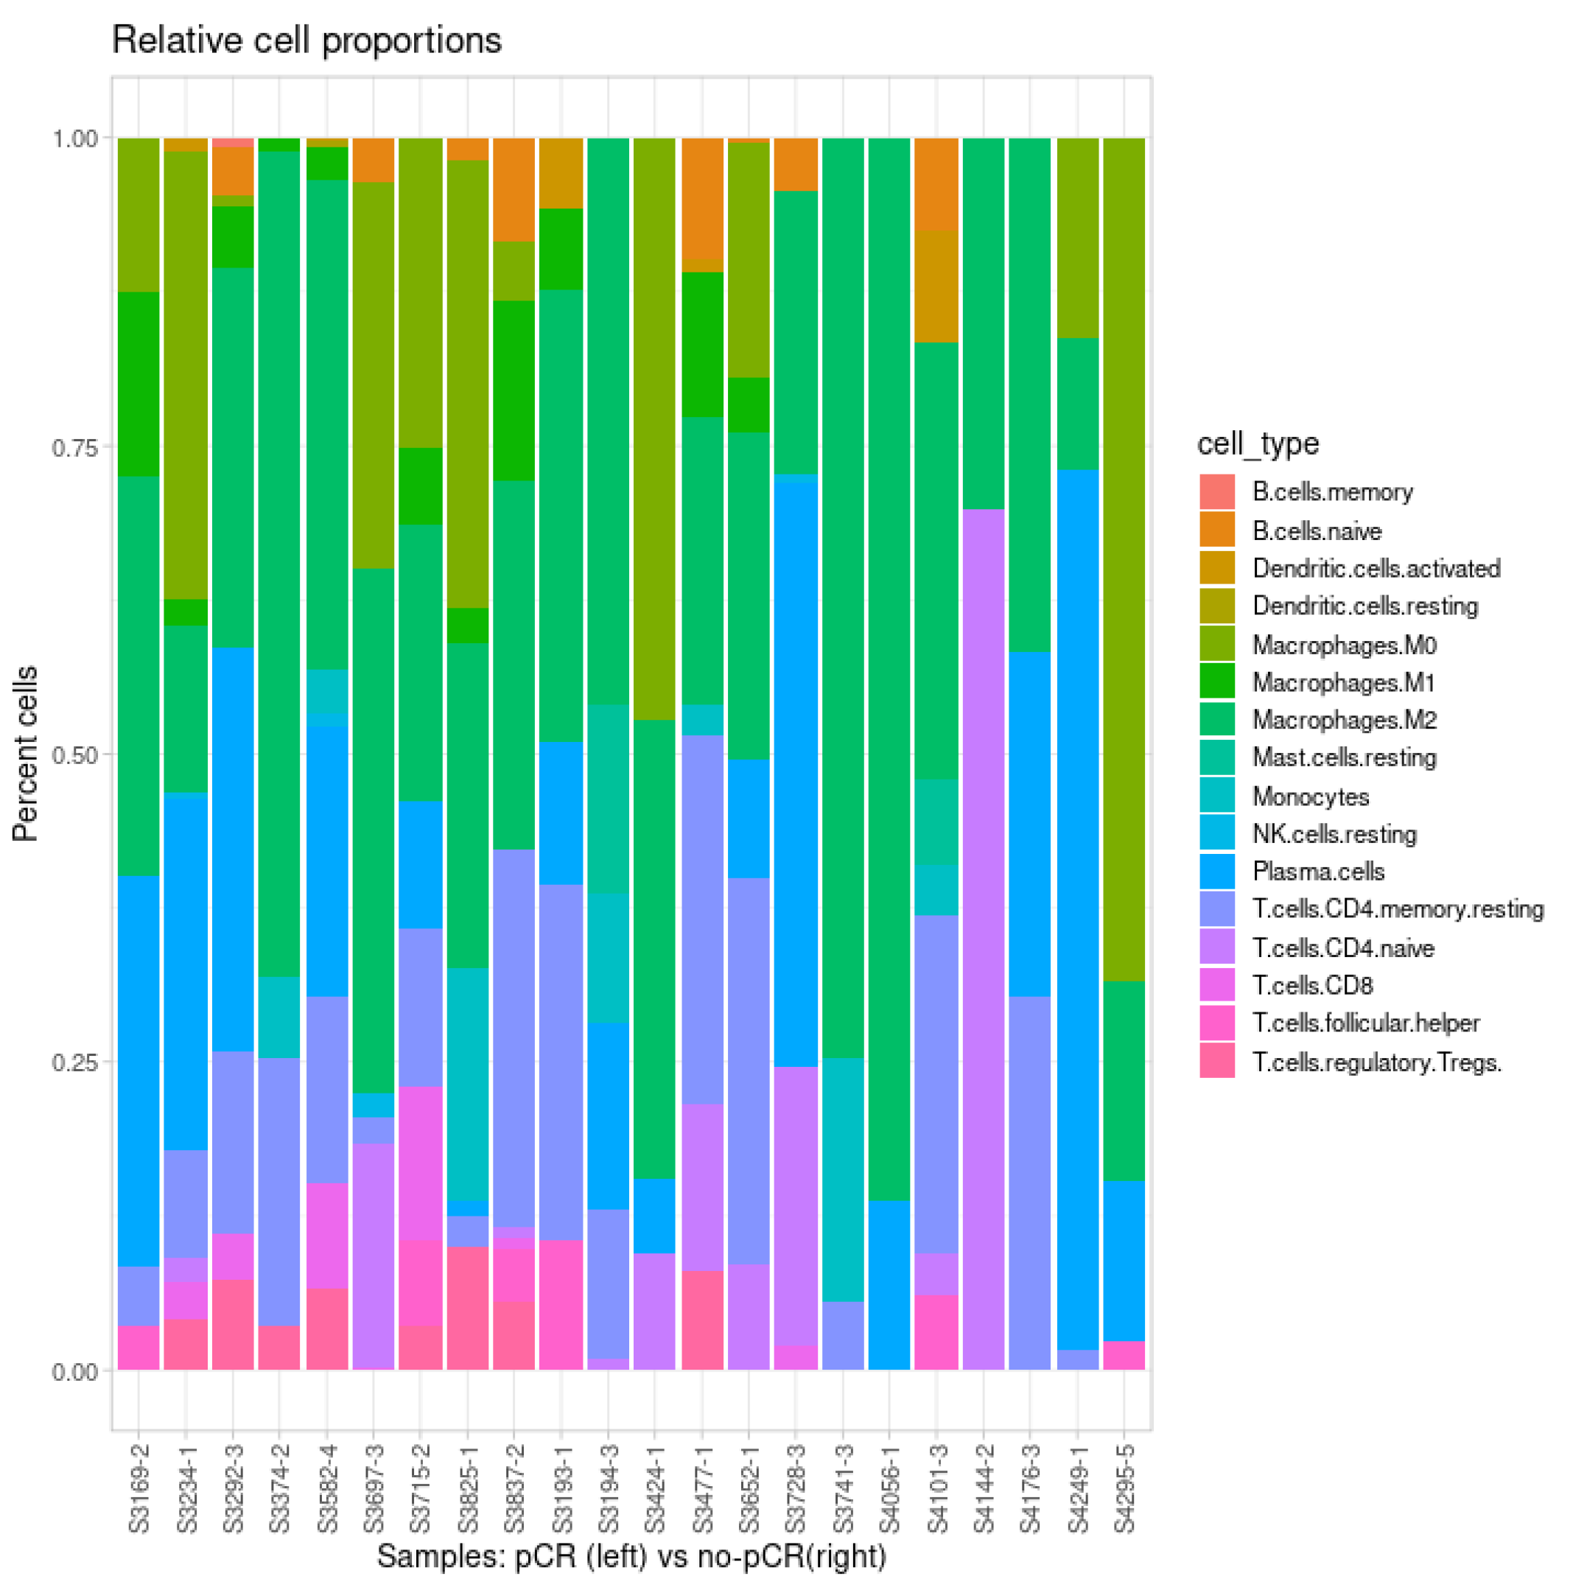
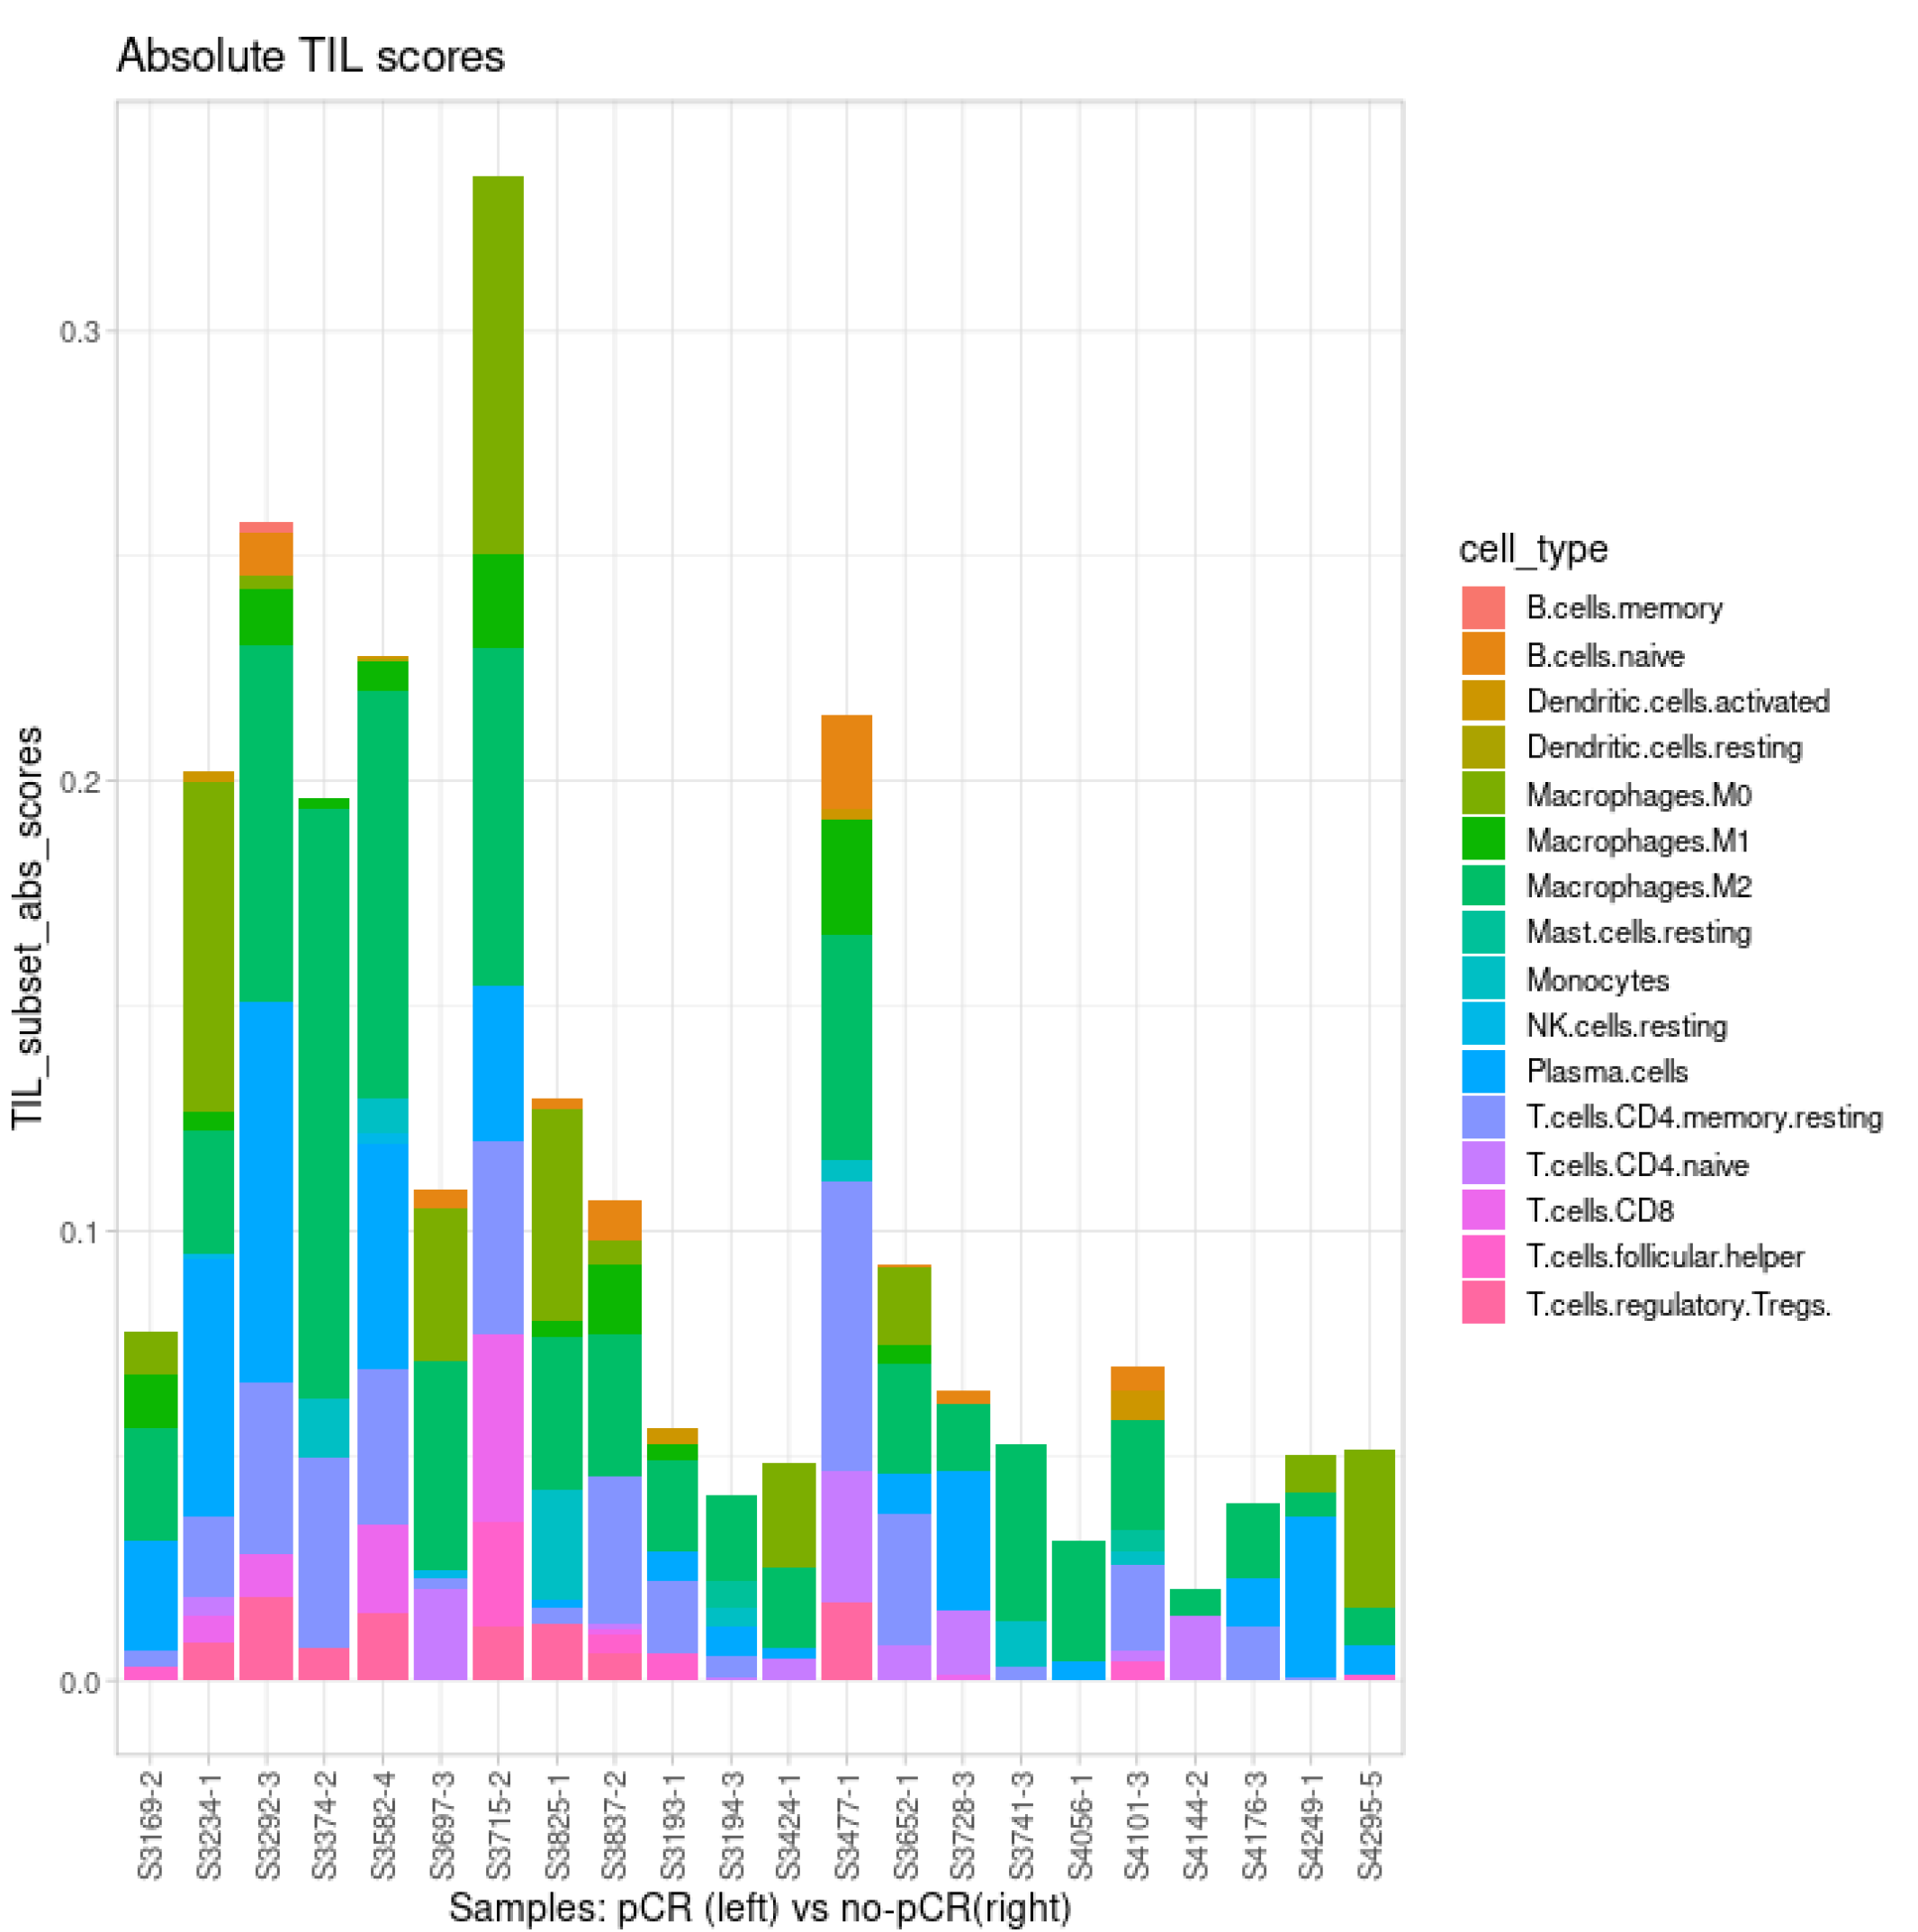
A
Relative cell proportions
B
Absolute cell scores
Percent cells
Subset absolute score
pCR
Non-pCR
pCR
Non-pCR
C
D
Figure 6
Notes:
Figure 6. Deconvolution of tumor infiltrating immune cells. FARDEEP was used to enumerate immune cell subsets from whole tumor tissue samples using the LM22 signature matrix. A) Relative cell proportions and B) absolute cell scores are shown. Distributions of several selected cell types are plotted by relative (C) and absolute (D) values. Statistical analyses were performed using two-tailed unpaired t-test. Error bars represent ±S.E.M. *, P < 0.05; **, P < 0.01; ****, P < 0.0001.

